Slide 1

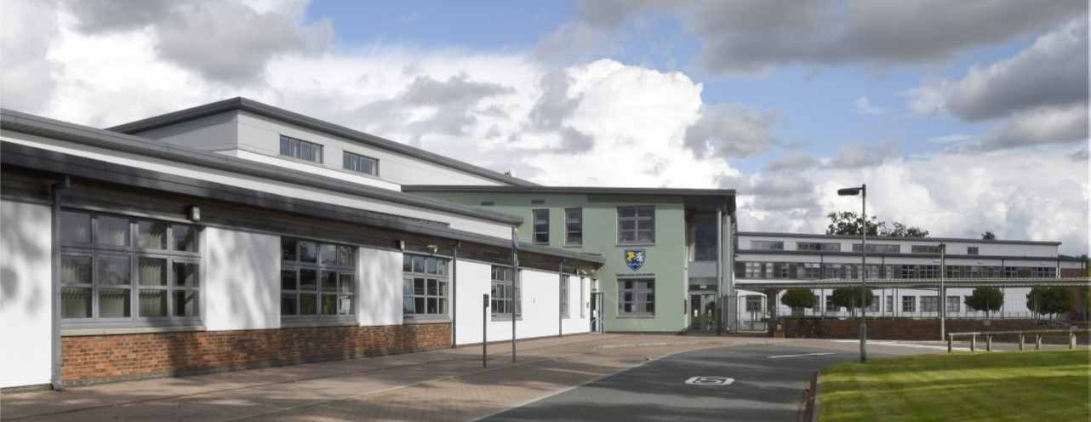
Wallace Hall Academy

Slide 2
Wallace Hall Academy – School Context
School role – approximately 570 pupils
S1 (2025-26) – 93 pupils
4 non-practical classes (1C1, 1N1, 1N2, 1S1)
5 Practical classes (1P1-1P5)
Pupils from 17 different Primary Schools

Slide 3

Principles of an effective Lesson
“In all departments, teachers use a range of assessments to inform subsequent planning of learning and teaching. This is a major strength of the school.”
(HMIE Inspection Report, 2025)

Slide 4

Supporting Positive Behaviour
“staff and young people maintain very positive and mutually respectful relationships. This nurturing and supportive culture creates a positive climate for learning.“
(HMIE Inspection Report, 2025)

Slide 5
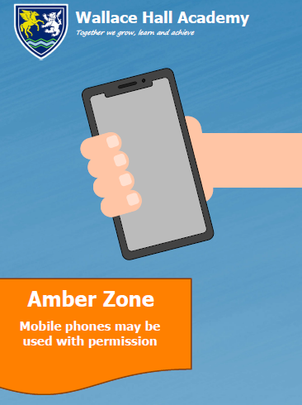
Supporting Positive Behaviour
Mobile Phones
  Do pupils need a mobile phone to attend Wallace Hall? No!

Slide 6
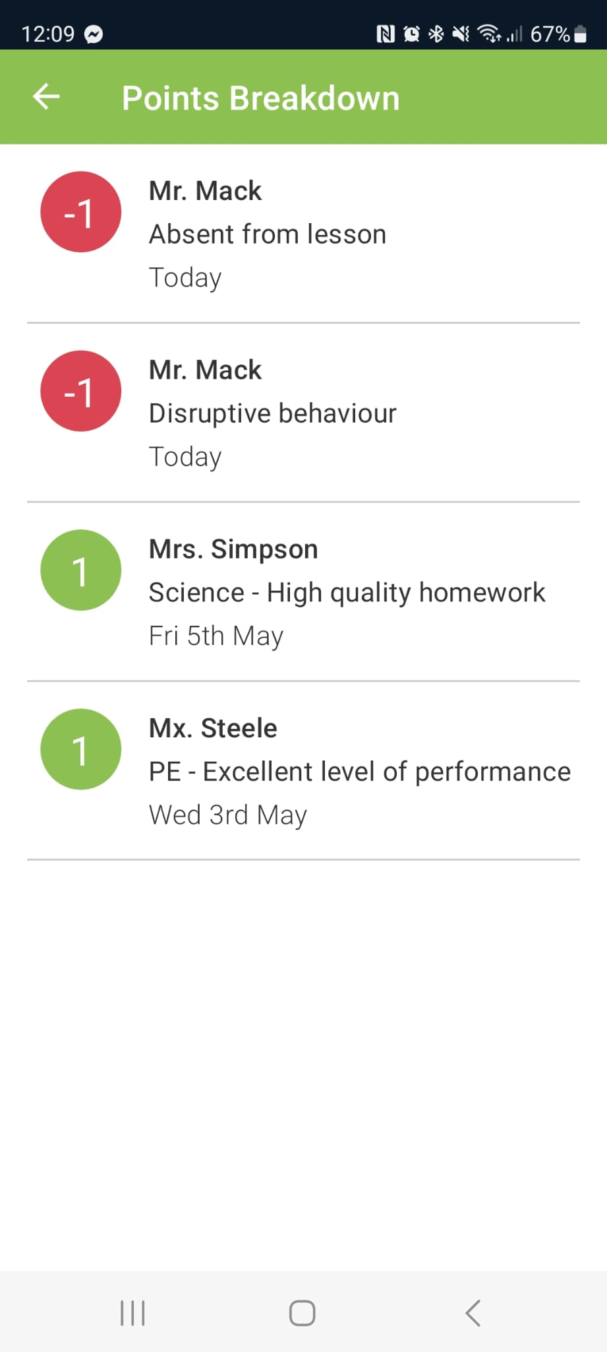
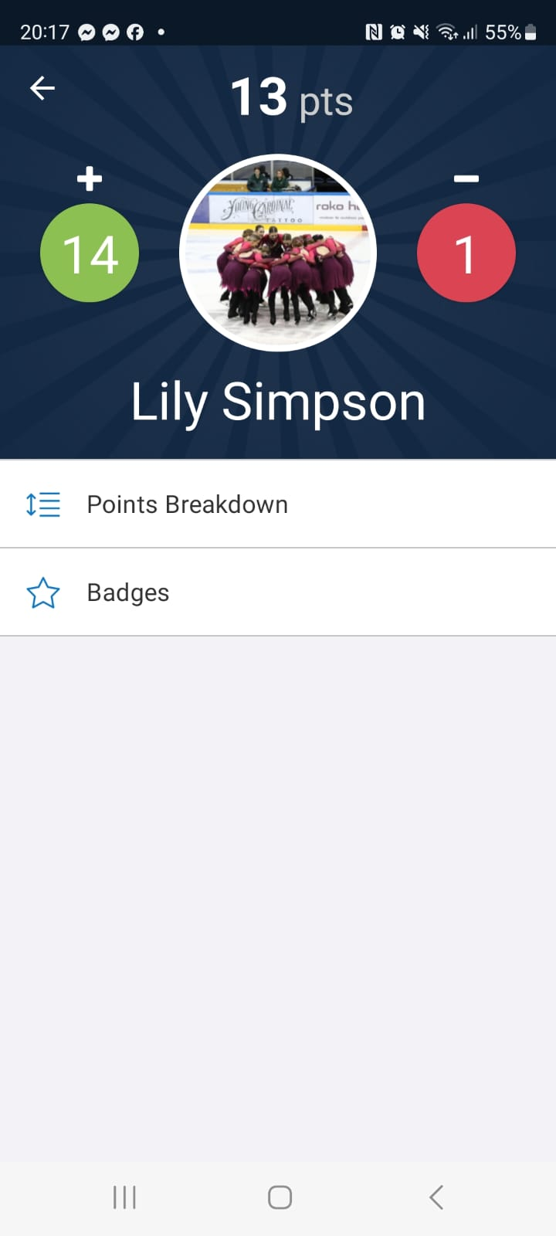

House System and House Points

Slide 7
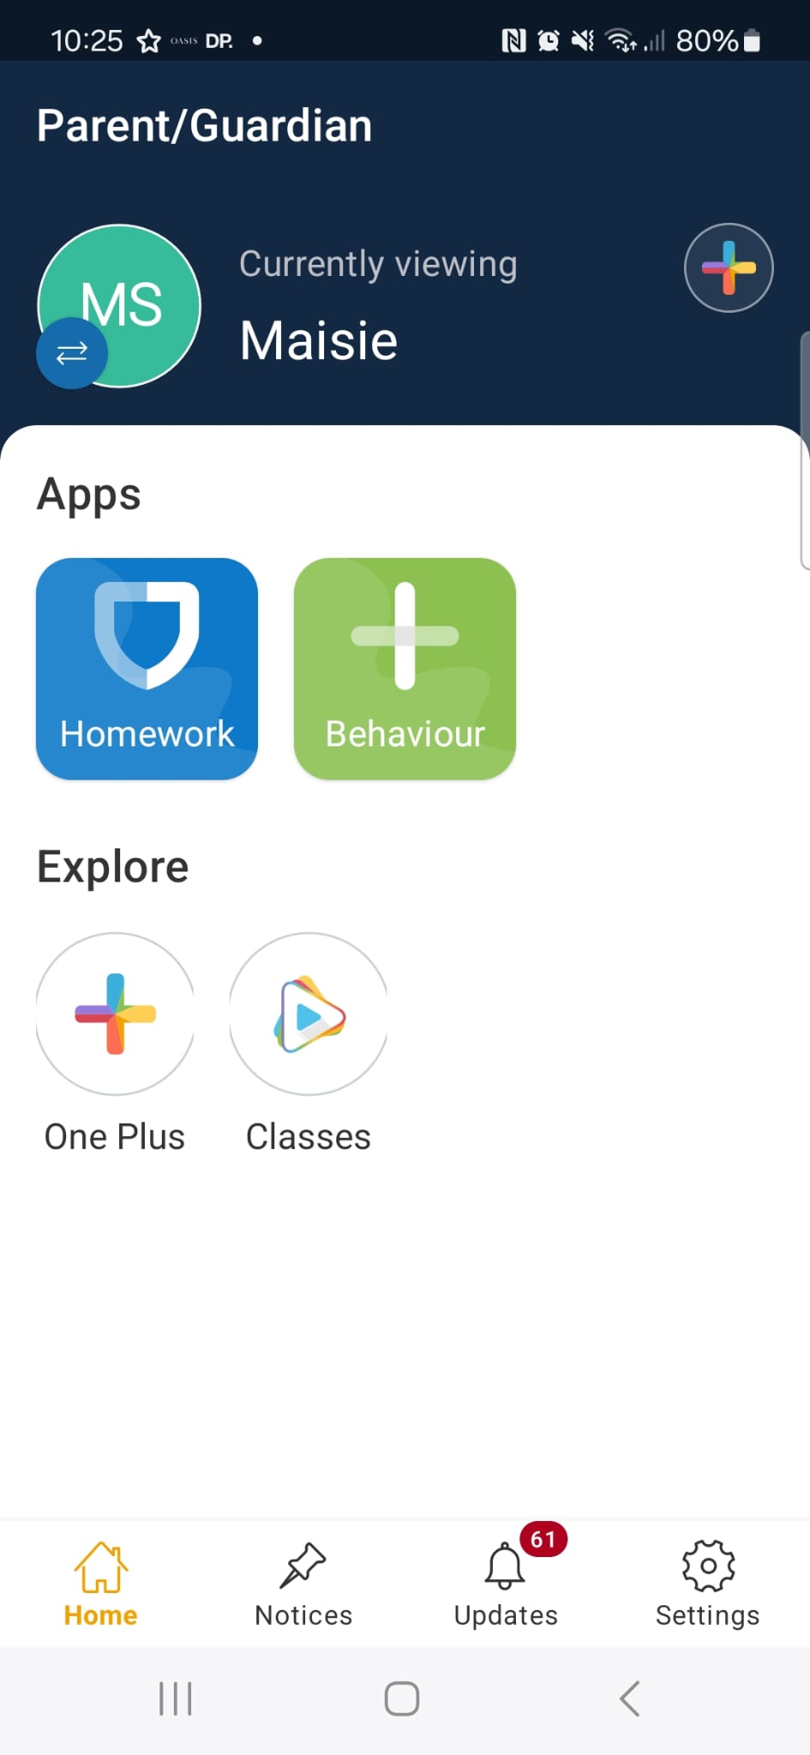
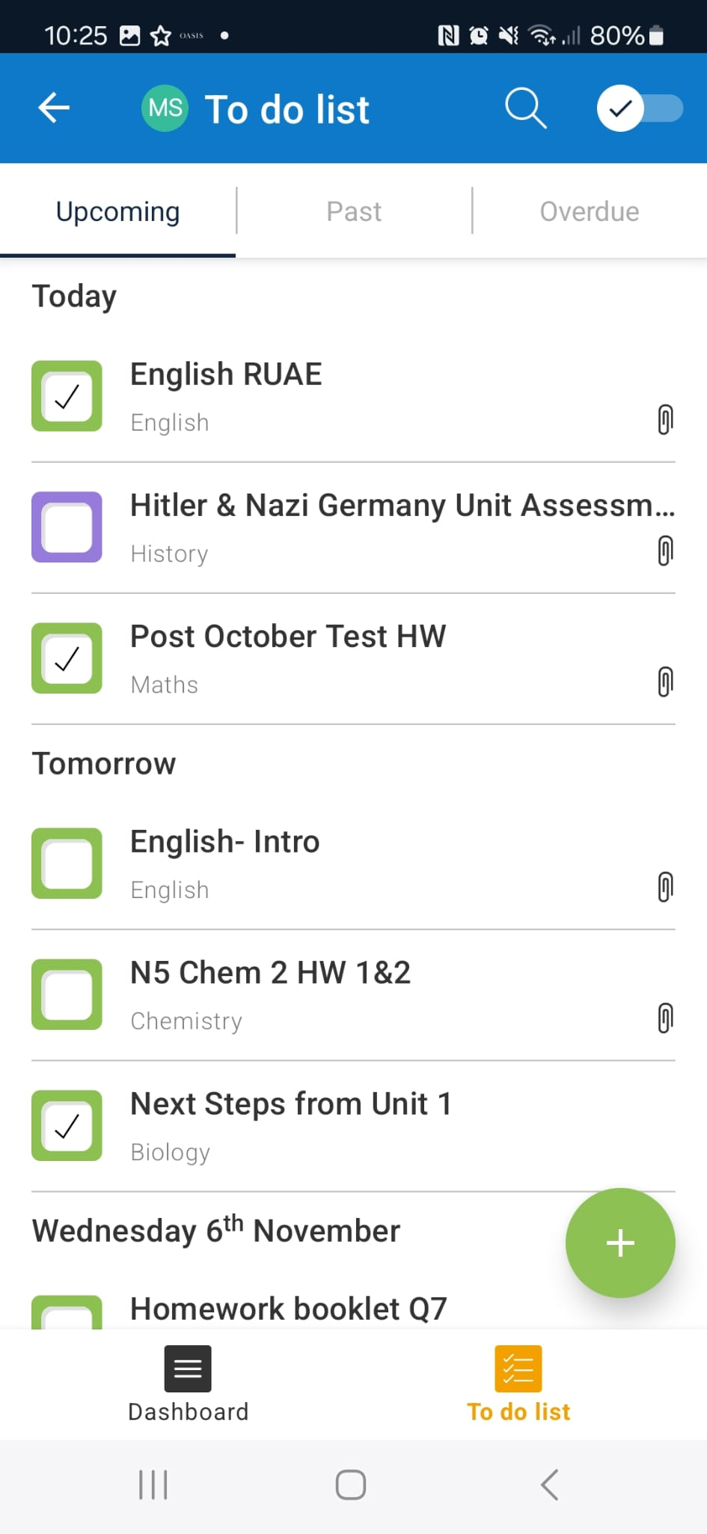
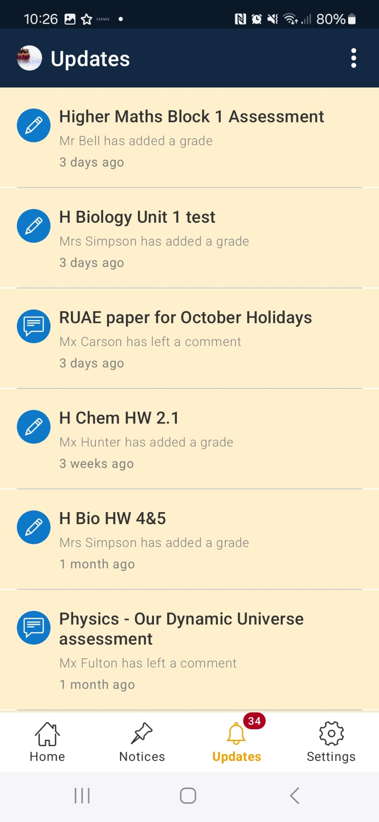
Satchel One
“The use of these digital platforms supports young people to study independently and take greater responsibility for their learning.”
(HMIE Inspection Report, 2025)

Slide 8
School Transport
School Transport service run by D+G Council
Pupils are entitled to transport if they live outwith 3 miles from the school are within the catchment area
Parents responsibility to transport pupils to nearest bus stop
Non-entitled pupils that live within 3 miles can apply for Grace and Favour places on existing buses
Pupils outwith catchment will have to make their own travel arrangements usually using the 236 or 246 buses

Slide 9

Raising Attainment and Achievement
Recognising Wider Achievement

Slide 10
Netball
School Show
Football
Extra-curricular Opportunities
Art
Japanese
Warhammer/Chess
Fitness
Music

Slide 11



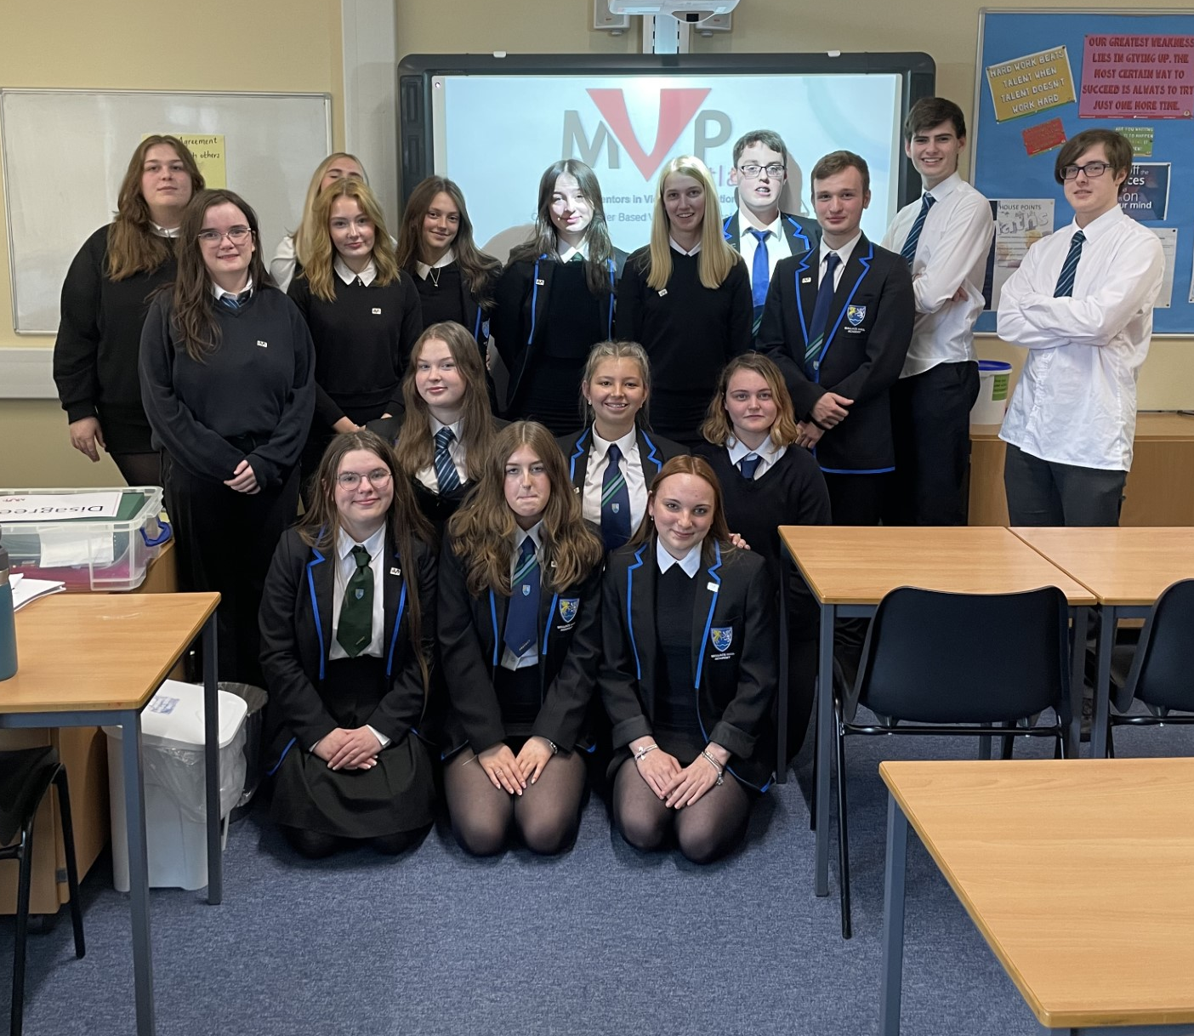



Wellbeing, Equality and Inclusion
“The school’s highly-effective approach to wellbeing is underpinned by strong approaches to monitoring and evaluating school practice. Almost all young people have a strong sense of belonging to their school.”
(HMIE Inspection Report, 2025)
“Staff and young people promote and celebrate equality and diversity across many aspects of school life.”
(HMIE Inspection Report, 2025)
Equality Group

Slide 12

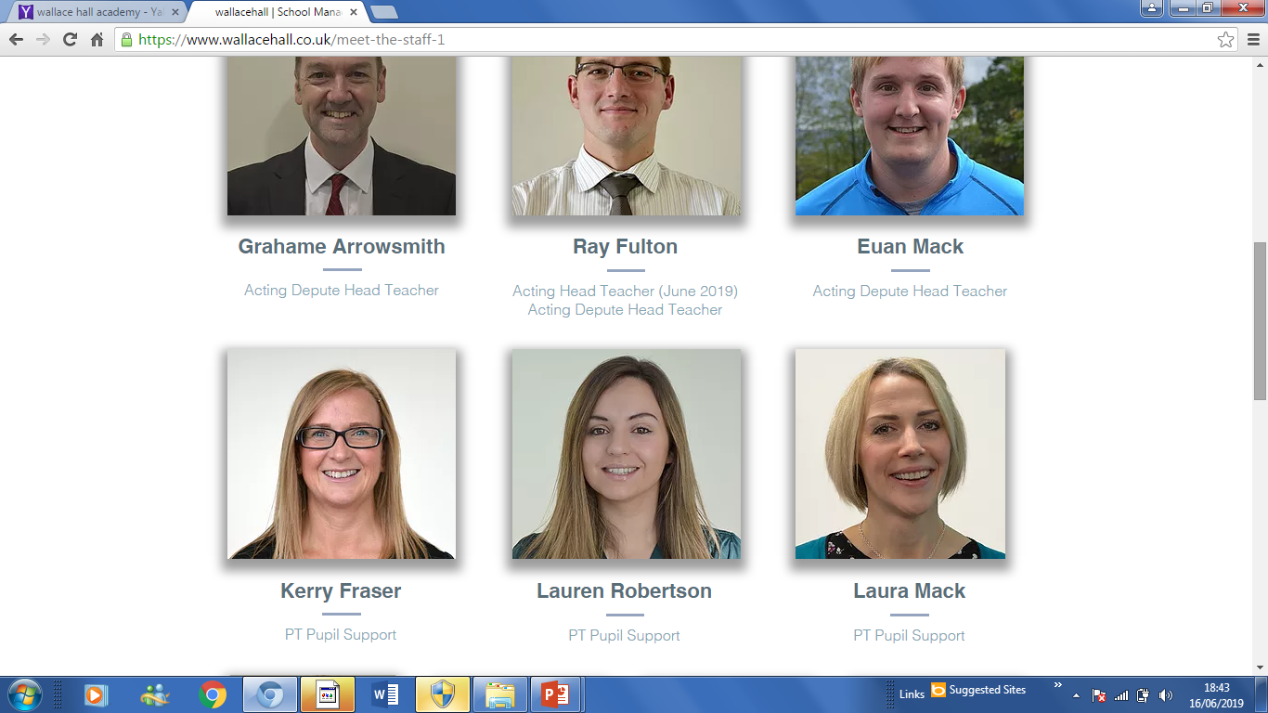
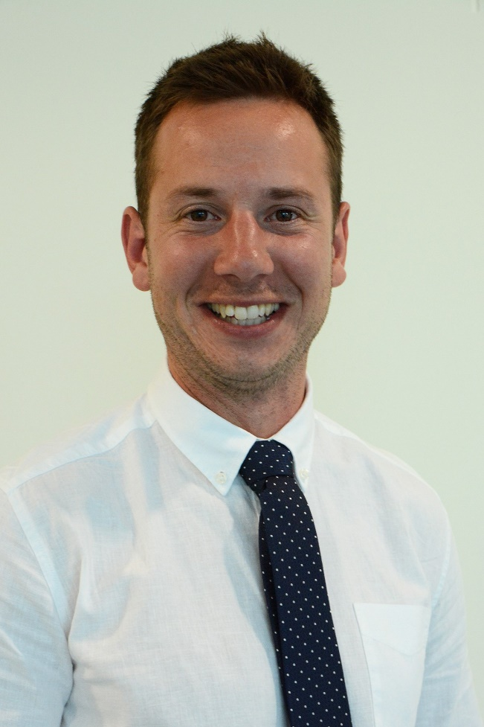
Pupil Support Team
Cairn
Nith
Scaur
Mrs Flint
Mrs Fraser
Mrs Mack
Mr Laverty and Mrs Robertson
PT Pupil Support
PT Pupil Support
PT Additional Support for Learning
PT Pupil Support
“Senior leaders, pastoral and SfL teams are proactive and highly effective in addressing the needs of young people who require additional support with their learning or wellbeing.”

Slide 13
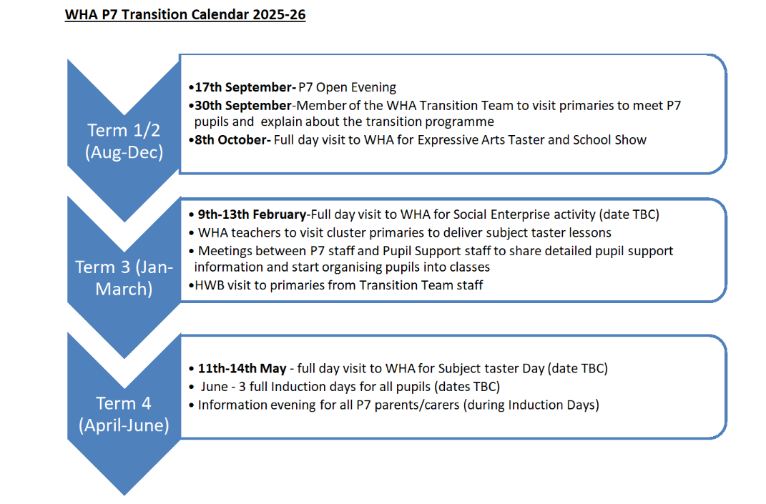
Transition Timeline
“Staff receive detailed, high-quality information relating to young people and their learning needs as part of transition processes at all stages.” (HMIE Inspection Report, 2025)
Notes:
13

Slide 14
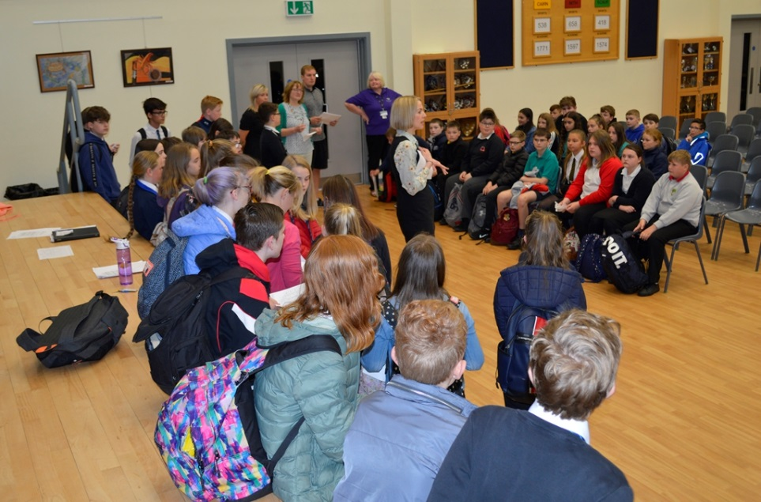
Visits to Primaries
by teaching and support staff
Pupil Info. Icon
Sharing Information
Primary / Secondary teacher meetings
Pupil information sharing meetings in June
PTPS attend joint planning meetings
Notes:
Maths/modern languages across cluster increasing to further strengthen continuity in curriculum and help us build learning picture of new S1. After planned meetings go to enhanced. Highlight fact that we confident in doing this effectively for non cluster too-this year we had pupils from an additional 10 primary schools, established relationships and processes ensure smooth transition for all.
14

Slide 15
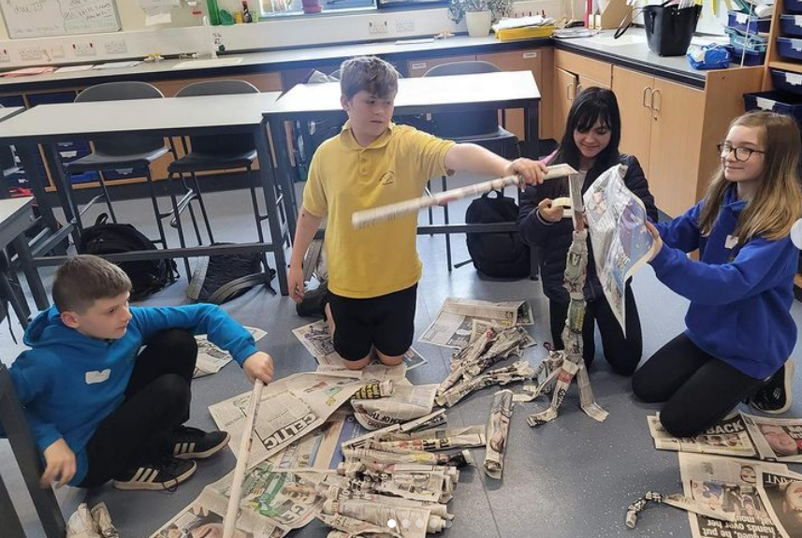
Enhanced Transition
How does
it work?
Individual pupils identified by primary staff
Transition programme is tailored to individuals needs
What does it
look like?
Individual school tours
Joining S1 classes to experience a lesson
Meeting and working with key staff
Secondary ASN staff visit primaries to work with individuals
Secondary staff attend planned meetings
Talking to the family and the young person
Additional small group transition visits in term 4

Slide 16
Targeted support
Getting to know every pupil as an individual
Identify strengths and barriers
Adapt their educational experience to support their learning and personal development
Study Skills
Literacy/ Numeracy Support
Nurture
For pupils with ASN and require support in mainstream classes
Extracted from Modern Languages
Develop pupils’ awareness of learning strategies and techniques (gathering and processing information, memory techniques and revision tools)
Additional support with literacy and numeracy skills
Literacy/ Numeracy groups
Paired reading with senior pupils
Lexonik programme
Nurture groups
The Hub
Peer Mentors
PEF Interventions

Slide 17
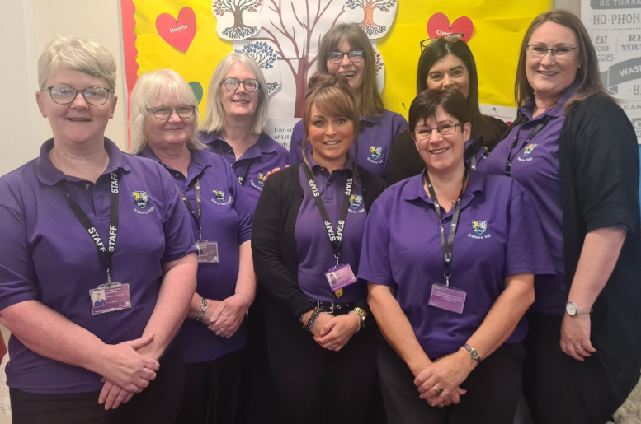
Learning Support Team
“Learning assistants provide invaluable help to targeted young people in and outwith lessons.”
(HMIE Inspection Report, 2025)

Slide 18
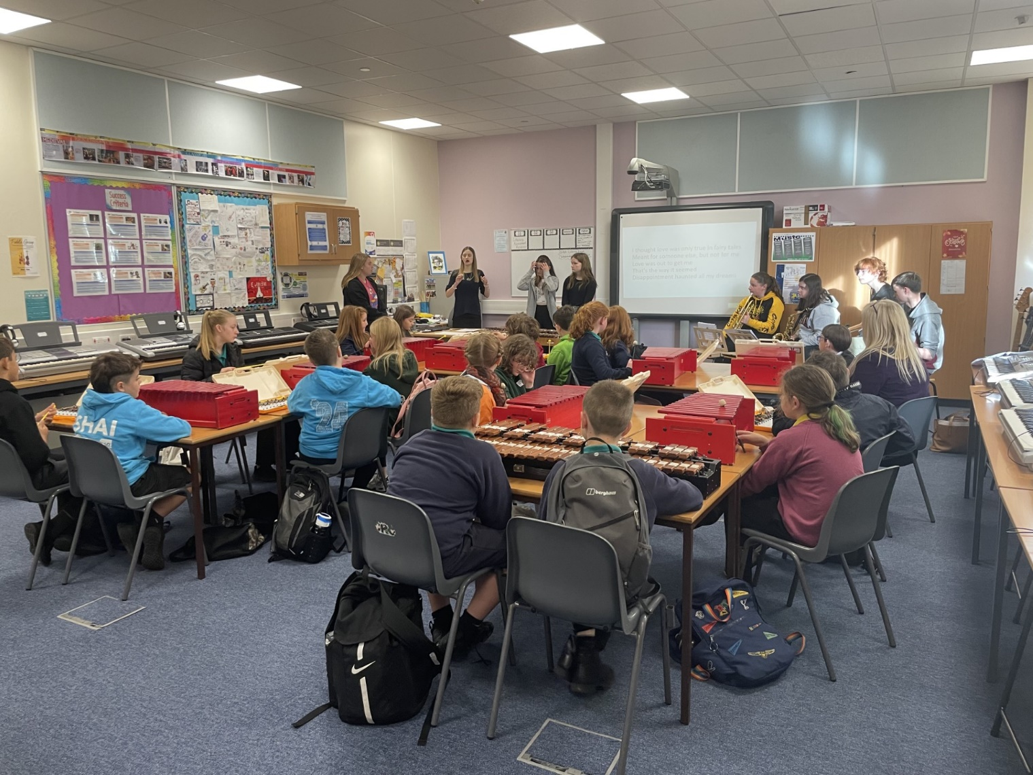
Effective partnerships
In school Support
Autism Outreach
School Nurse
Youth Work
School Police Officer
Skills Development Scotland

Slide 19
What happens now?
Each primary 7 pupil will be issued with either a S1 Catchment Form or S1 Placing Request Form to apply for their choice of secondary school.
These will be issued week commencing 29 September 2025.
The completed forms should be returned to the primary school as soon as possible. The deadline for returning to Primary Schools is Friday 31st October.
D+G Council will inform you of your place in secondary school by the Christmas holidays

